Slide 1
Prototype Crowded game Zombie Horde Shooter
Group 1B
Joel Brieger, Nikos Giakoumoglou, Gianmarco Picarella

Slide 2
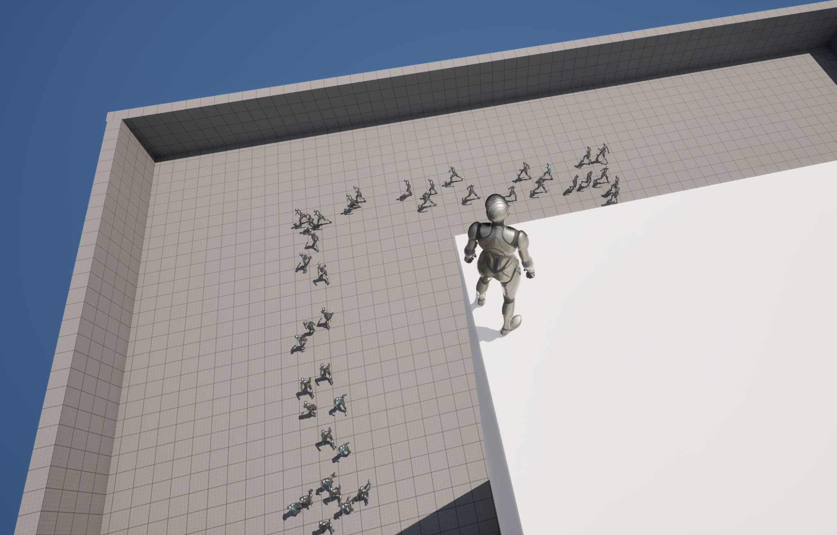
Original idea - Tower defense
Zombie horde attacks the tower from every direction
The player must protect the tower for as long as possible

Slide 3
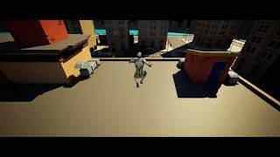
What we had last time:

Slide 4
Assumptions we made:
Low poly models will be cheaper to render.
No physics colliders are required on the zombies.
All zombies move towards the same area.
No counter-flows
The player cannot reach the zombies
Player cannot zoom in

Slide 5
Encountered problems
Experimental status/Outdated documentation of UMass
Vertex animations
UMass avoidance integration with NavMesh
Large crowds can push agents into obstacles

Slide 6
Encountered problems:
Experimental status/Lacking documentation of UMass
Difficult to parallelize functions
Difficult to set tick rate of individual processors (Systems in ECS)
Built in avoidance trait is very inefficient.

Slide 7
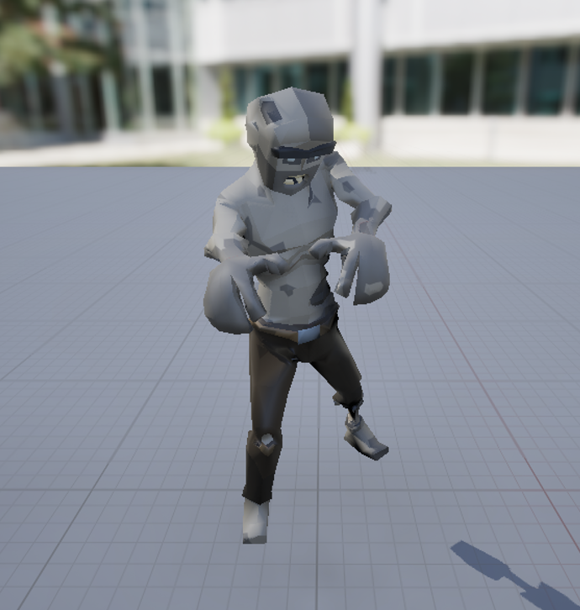
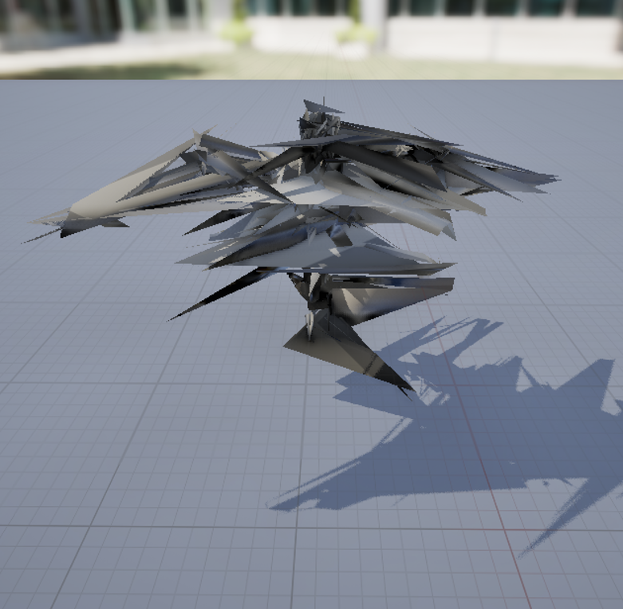
Encountered problems:
Vertex Animations
<< How it started
How it went >>

Slide 8
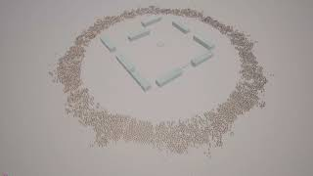
Encountered problems:
UMass Avoidance Integration With NavMesh (5k agents @50fps)

Slide 9
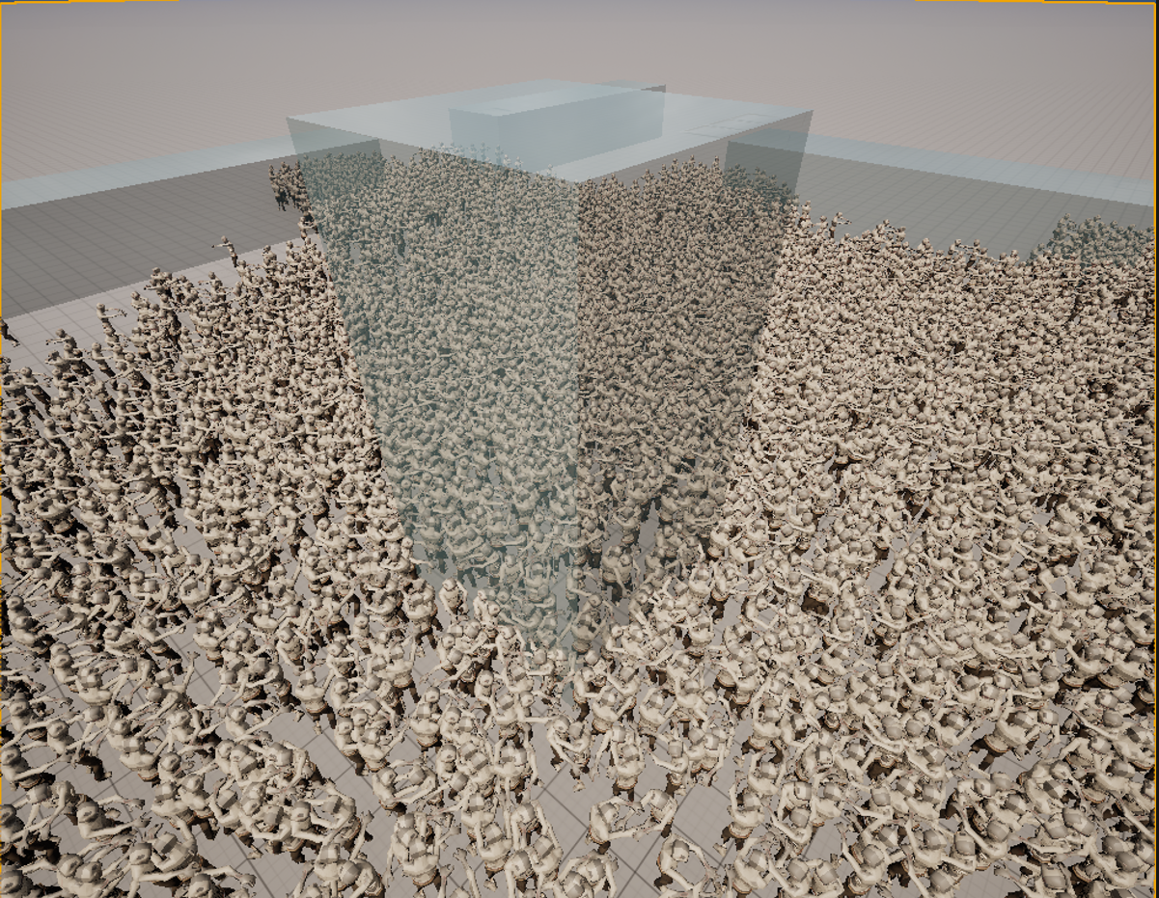
Encountered problems:
Large Crowds Can Push Agents Into Obstacles
Happens because the entities don’t have collision.
Partially solvable but out of scope.

Slide 10
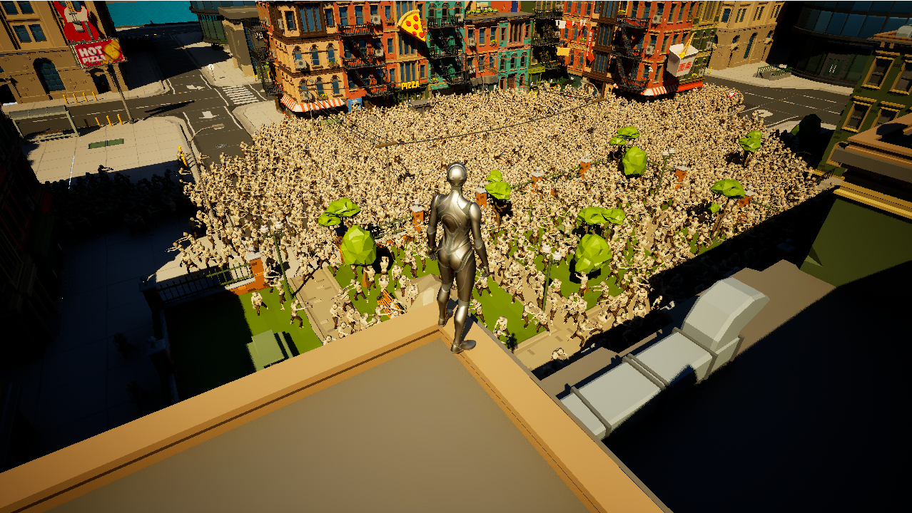
New Idea - Square defense
Zombie horde attacks the square from every direction
The player must protect the square

Slide 11
Making the Game a Game.

Slide 12
Health Status and Zombie Objective
Start with 100 health.
Zombies are all trying to navigate to a random position inside the main square
For every second there are more than 500 zombies inside the main square your health ticks down.

Slide 13
Player Character
Uses the built-in unreal FPS character controller
Added super-jump because it is more fun and easy to see the zombies
Makes for more forgiving gameplay since if you fall off the buildings you can jump back up
Player has a rocket launcher to fend off the zombies

Slide 14
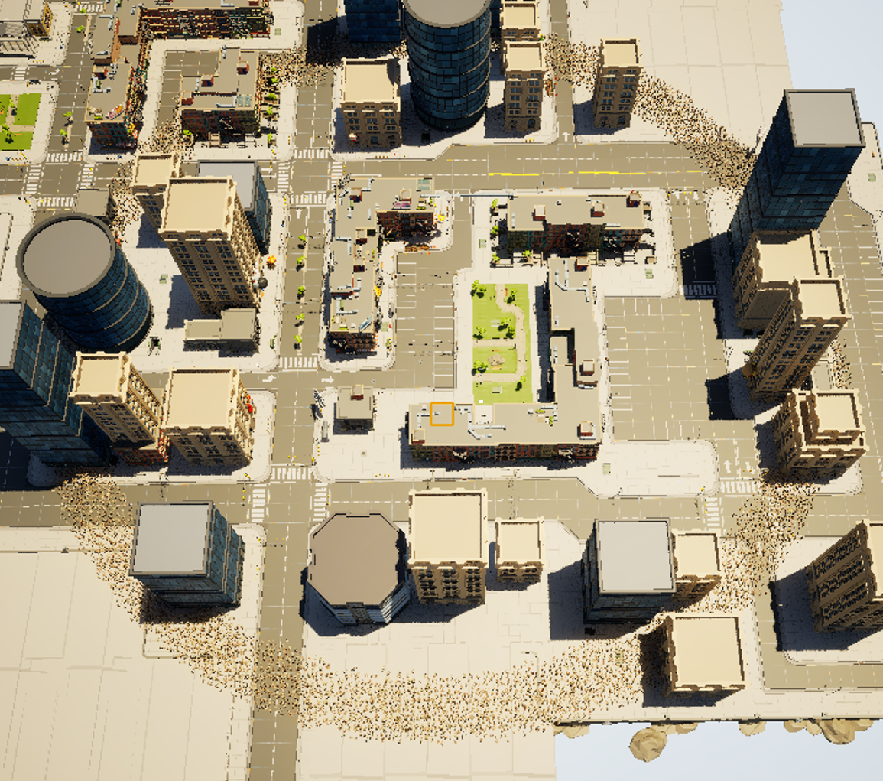
Zombie Spawn System
Zombies spawn in a wide ring around the city
Tests were performed using spawn points but this caused issues with the forces
Unfortunately we ran out of time to implement a more complex system

Slide 15
Avoidance
Initially we used the default avoidance system implemented in mass
Then we implemented a custom avoidance processor using a faster nearest neighbours algorithm
We improved the performance of the simulation from 50fps with 5k agents to 30fps with 10k agents
We used NanoFlann, a KD-tree based nearest neighbours library using a fixed radius search

Slide 16
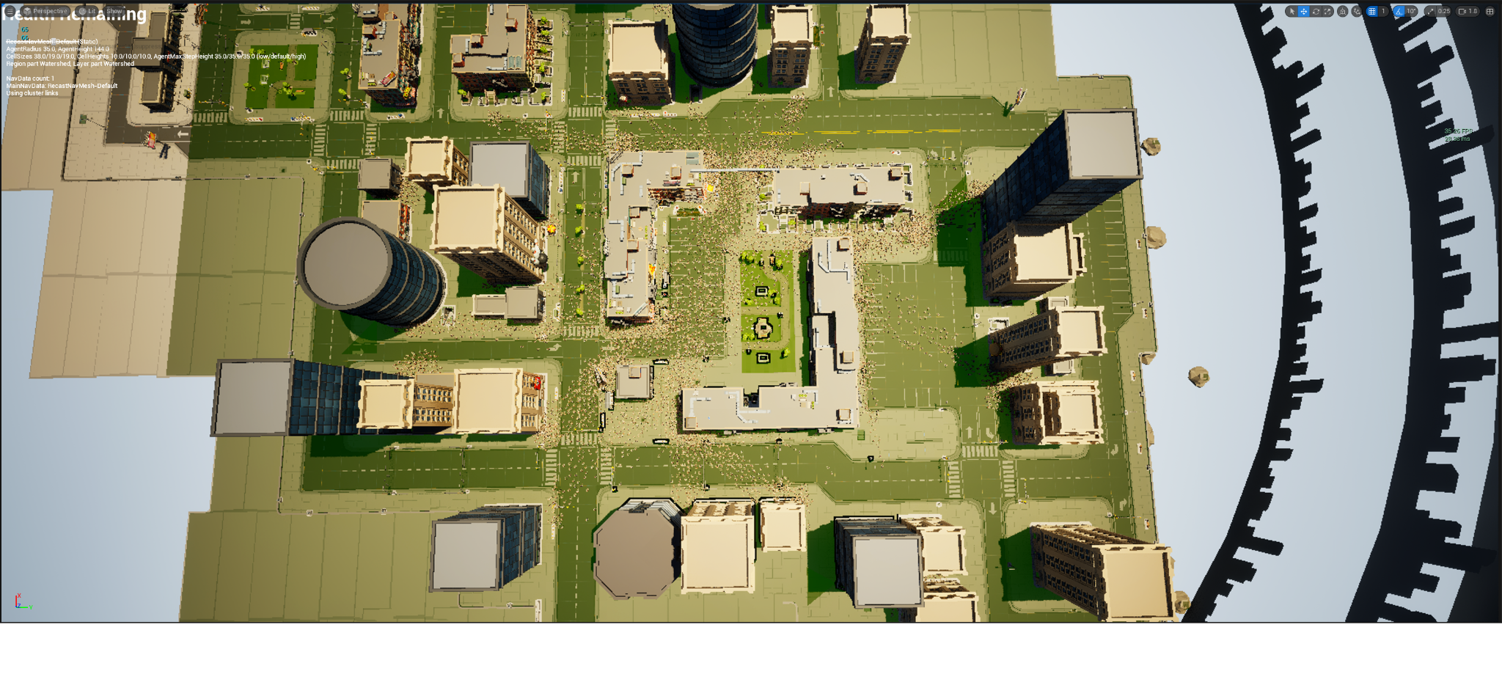
Additional Optimization
Each agent shares approximately the same neighbours across subsequent frames
Agents can be grouped and updated across multiple frames reducing computation time
Initial tests showed this method allows us to manage more than 40k agents with playable frame rates

Slide 17
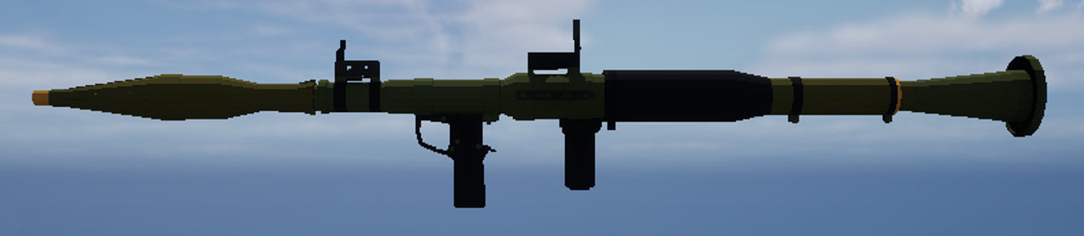
Rocket Launcher Mechanics
Initially you had to reload the rocket launcher (~2s)
Then we realised that made the game impossible so we made it full-auto.
More fun to have a fully automatic rocket launcher
The projectile hit location and the explosion radius are used to locate the agents that should be deleted using the same functions as NanoFlann

Slide 18
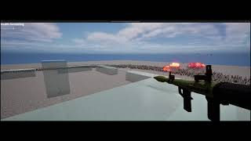

Slide 19
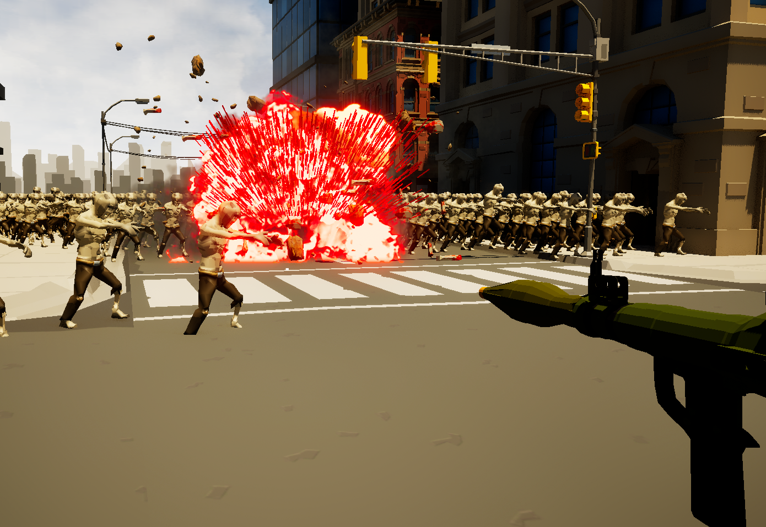
Visual Effects
Made up of multiple different niagara particle effects
Rocket launcher explosion effect
A blood and guts effect that’s based on whether or not you hit a zombie
Initially we tried to implement it so that it would scale the blood and guts based on the number of zombies hit but that was scraped for performance reasons

Slide 20
Limitations, shortcuts, and pitfalls
Zombies still get stuck on terrain
Rocket launcher radius is 2-dimensional and drops the z values so you have to hit the ground to kill them.
The vertex animations cause the zombies to look unimpressive up close.
Zombies all play the same animation at the same time, with the same texture which looks very monotonic.
Zombies only play one animation so when they reach their destination they walk on the spot.

Slide 21
Testing Conditions and Results So Far
Subject to change in the final version
Tests were performed in the UE5 editor which is not ideal for performance
Test machine was a RTX 3080 and a Ryzen 5 5600x.
Tests show we can run 5k agents at ~60fps and 10k at ~30fps

Slide 22
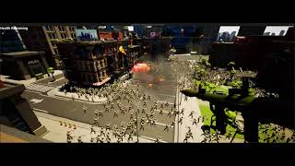
Final Result

Slide 23
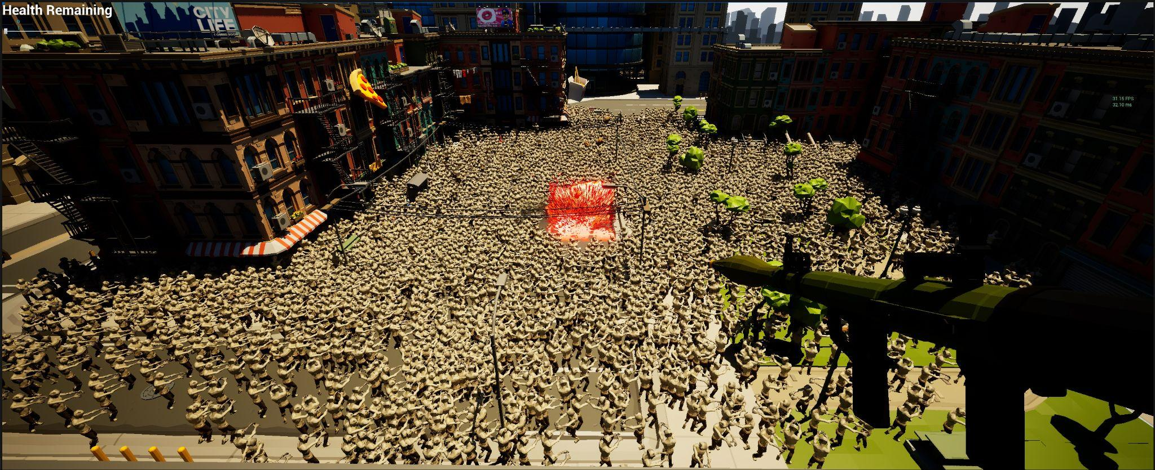
Thank you! Questions?

